Slide 1

BUS336: Hackathon

Slide 2
This Presentations Answers:
Over the years, has the growth in salaries kept pace with the increase in tuition fees?
How has the percentage of undergraduate students with debt over $25,000 changed from 2000 to 2020?
Which province provides the best ROI regrading employment in Canada?
Notes:
These are the questions we'll be looking to address in this presentation, first of all we'll look into the growth of salaries that students secure after their graduation in comparison to the increase in tuition fees. Furthermore, to expand this research we'll analyse how has the percentage of students with large debts changed from the year 2000 to 2020.
Conclusively, we'll be looking at the provinces which tend to provide the best ROI in terms of employment after graduation as a solution to tackle this inflation in tuition fees over the years

Slide 3
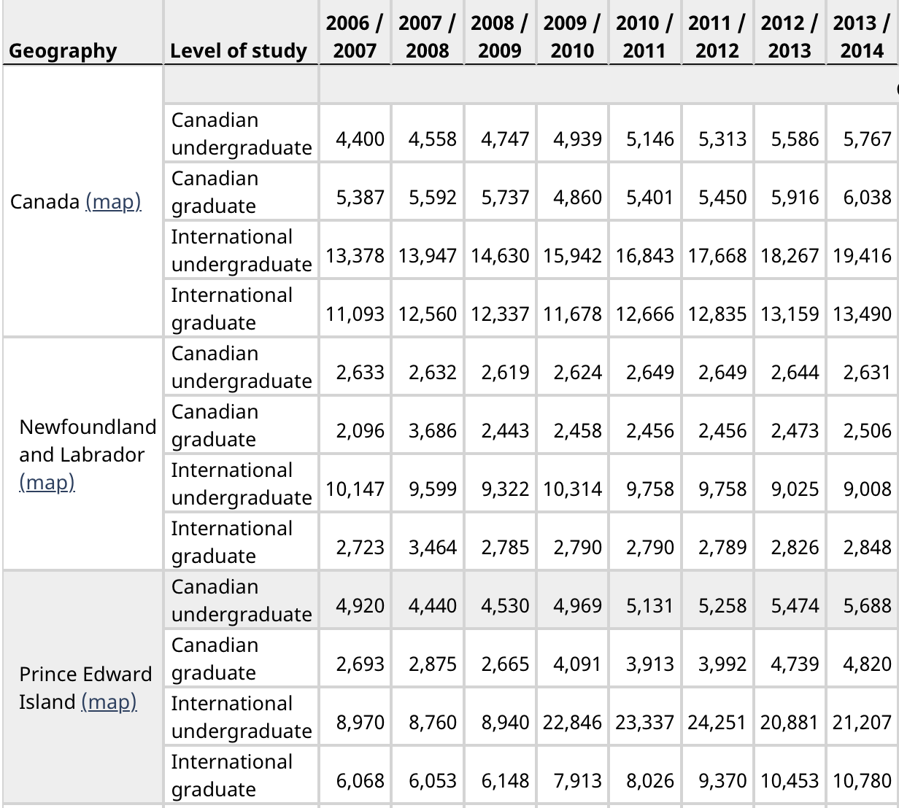
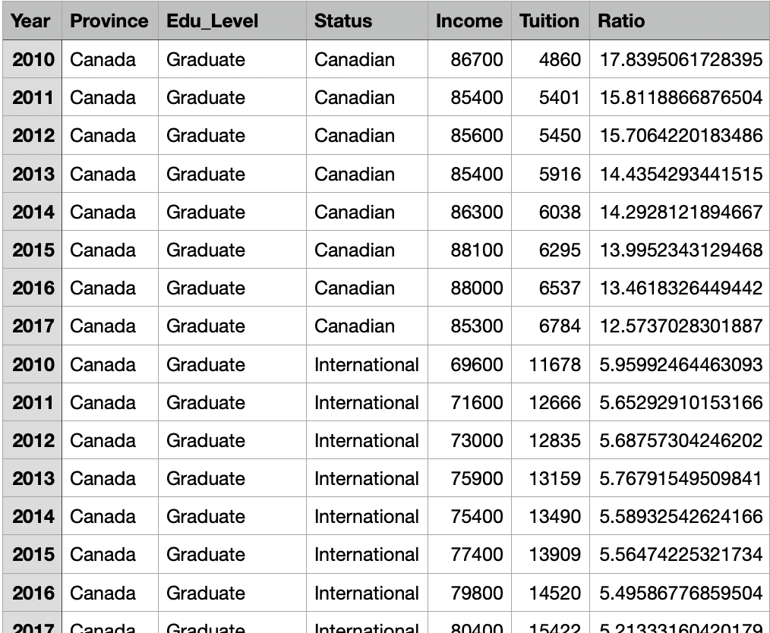
Data Cleaning & Preparation
Utilized R to convert raw data to ‘tidy’ data
Before
After
Notes:
So, the first thing we had to do to conduct our research was cleaning and tidying up the data using R that we collected from the stat canada website, as the raw data was not fit to be analysed.

Slide 4
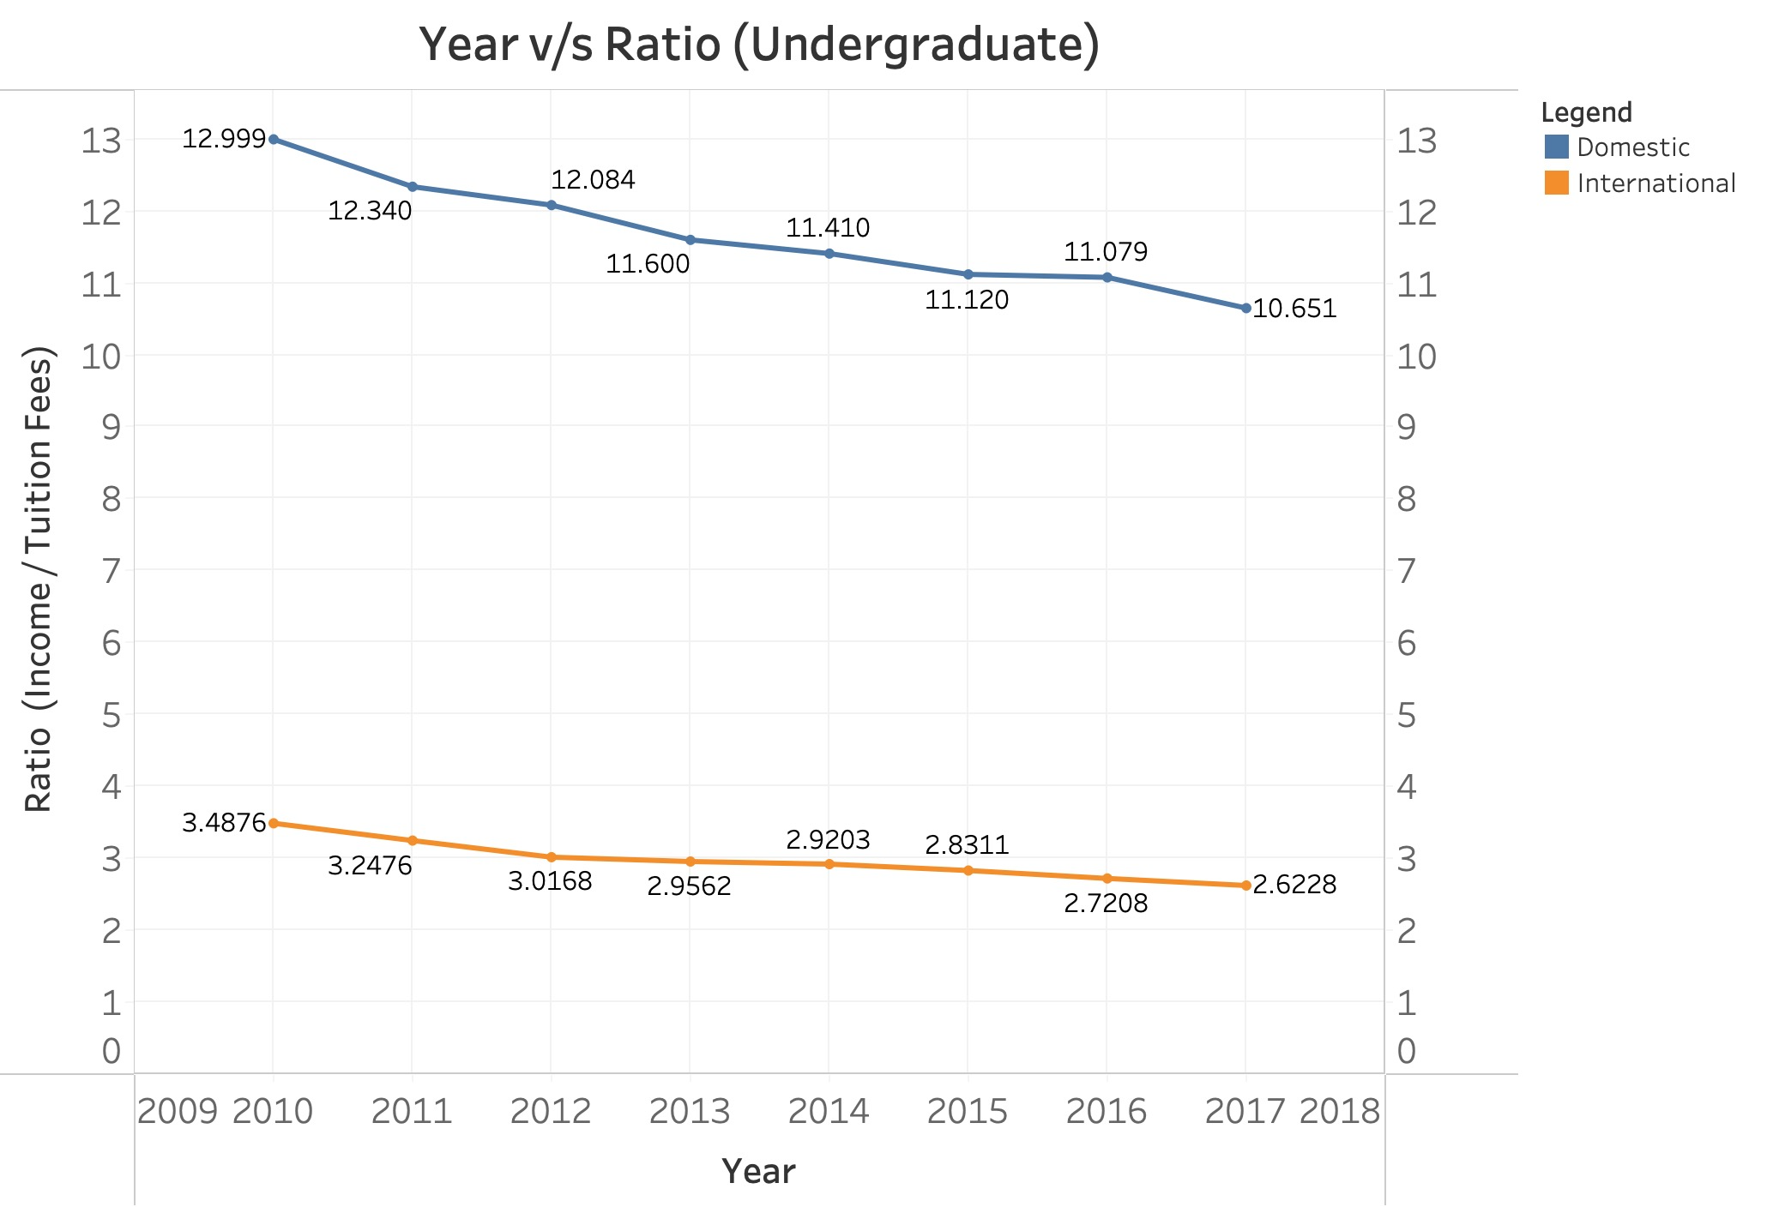
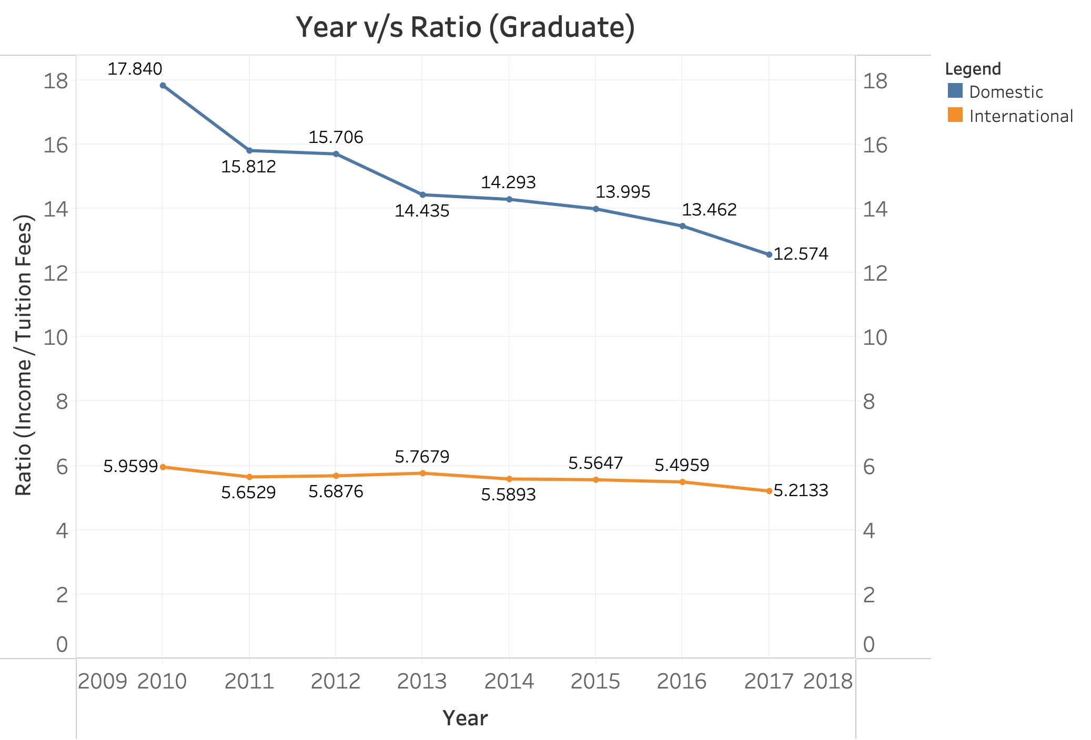
Has the growth in salaries kept pace with the increase in tuition fees?
Furthermore, the ratio for domestic students is declining at a steeper rate compared to that of international students.
The substantial disparity in the ratio between domestic and international students makes the investment in tuition fees appear unjustifiable for international students.
It can be inferred from both the graphs that students' incomes five years post-graduation are not rising at the same rate as tuition fees making higher education seem a less attractive prospect.
Notes:
We analyzed the income-to-tuition ratio for both undergraduate and graduate students, plotting the ratio (income 5 years after graduation divided by tuition fees) against their graduation year. As you can see each graph includes lines for both domestic and international students.
All in all our findings show a downward trend for all the lines, indicating tuition fees are increasing faster than incomes.

Slide 5
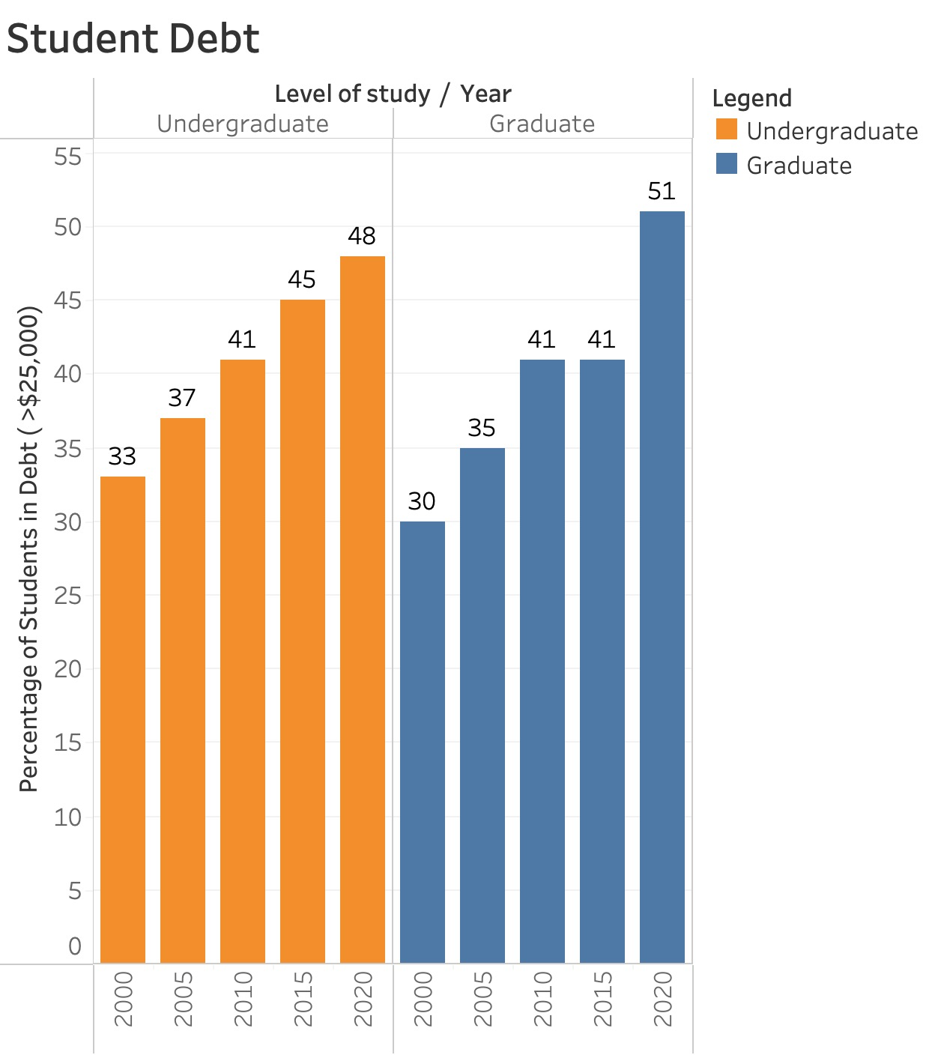
How has the percentage of undergraduate students with debt changed from 2000 to 2020?
The increasing percentages of students with debt over $25,000 align with the decreasing income-to-tuition fee ratios, highlighting the growing financial challenges students face.
The data collectively suggest that the rising cost of education and slower income growth are leading to higher student debt, emphasizing the need for policies addressing tuition affordability and financial aid.
Notes:
•As can be seen from the visualization, the data shows a concerning rise in student debt for both undergraduate and graduate students in Canada from 2000 to 2020.
•Coupled with the declining income-to-tuition ratio, as illustrated in the previous slide, this trend empasizes the urgent need for policies to improve tuition affordability and enhance financial aid for students.

Slide 6
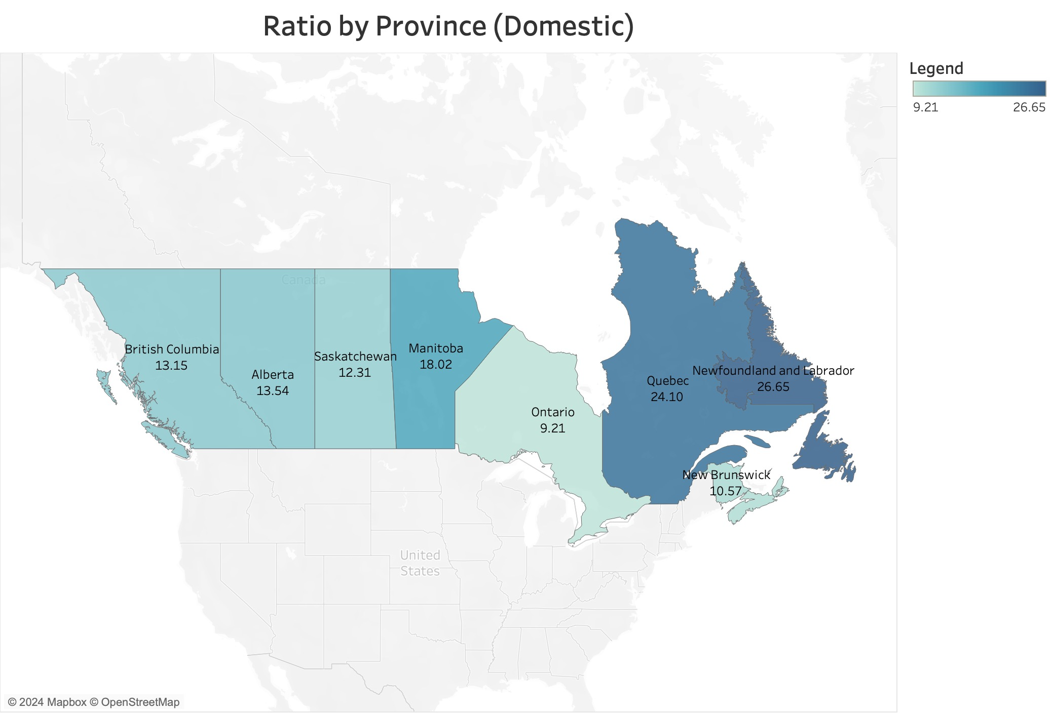
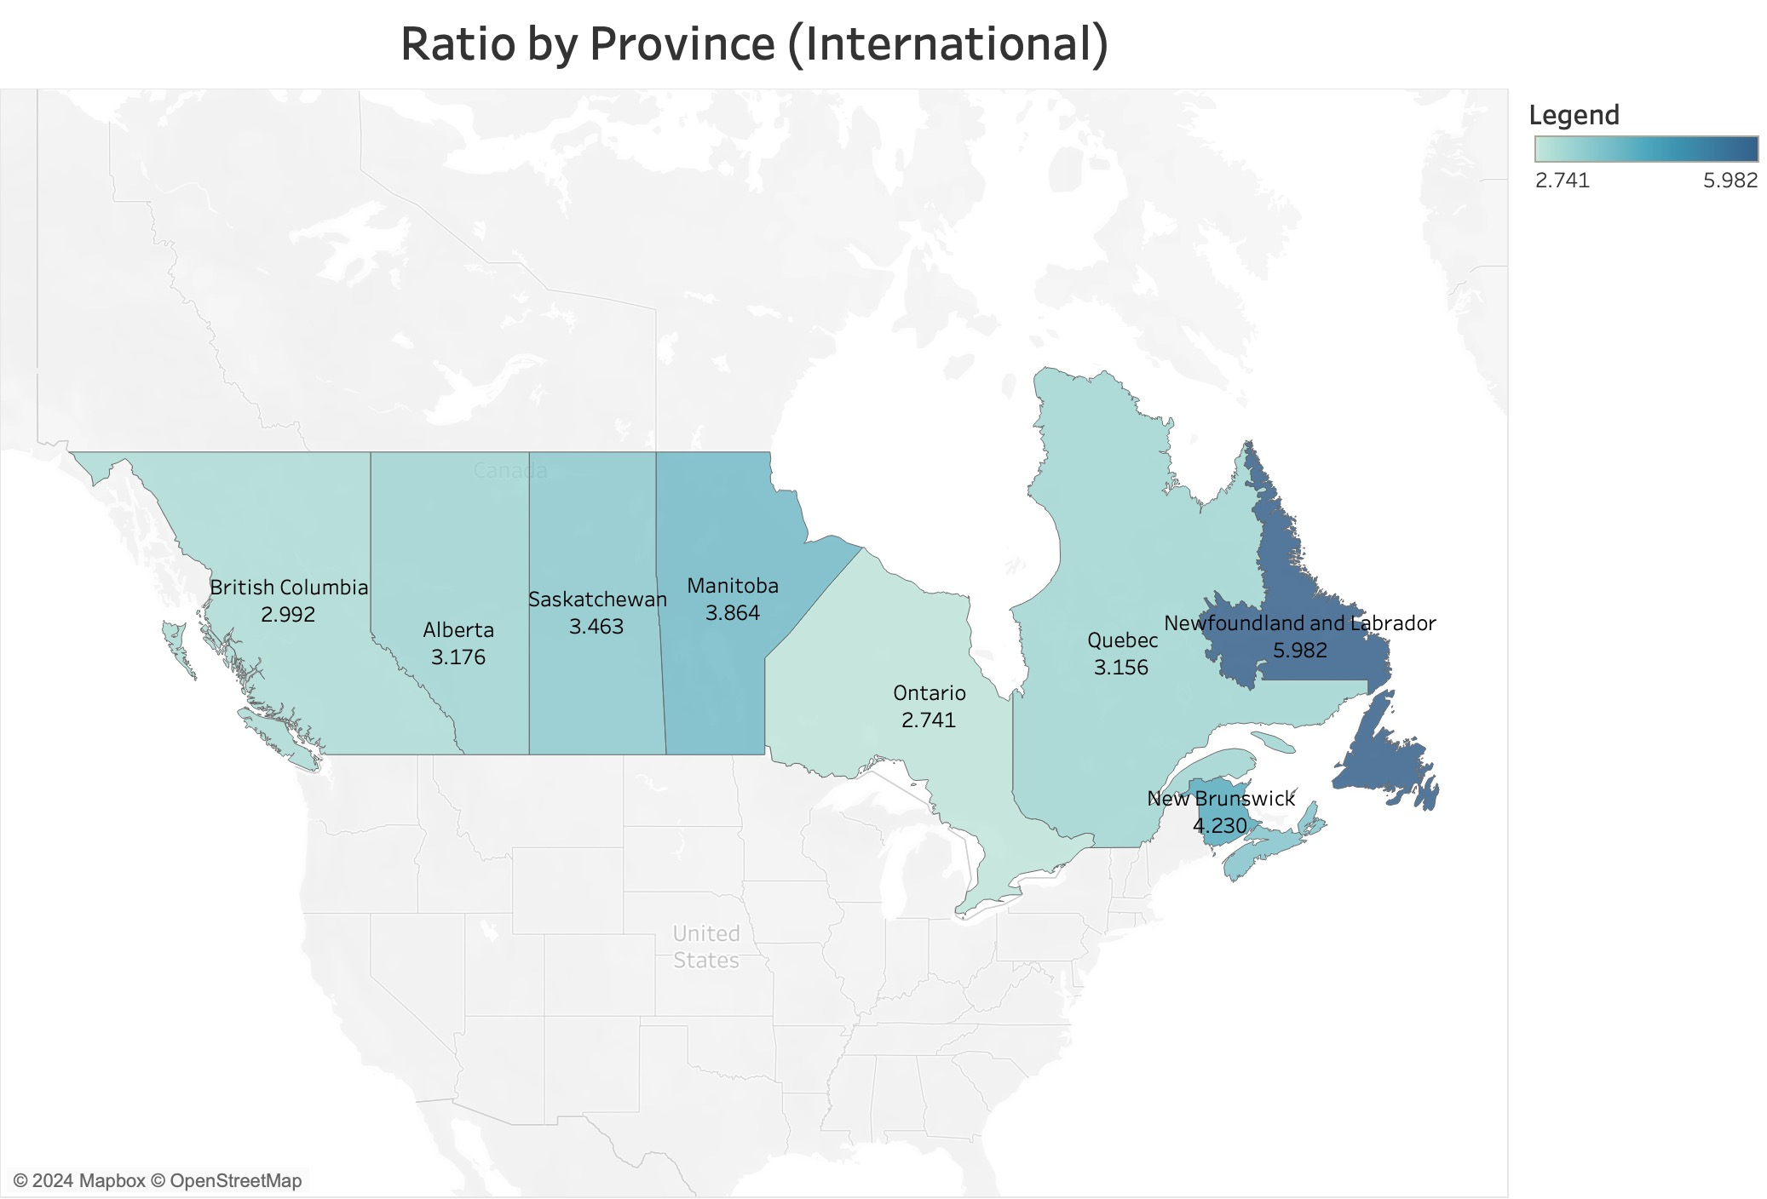
Which province provides the best ROI regrading employment in Canada?
The ratios for international students are generally lower across all provinces compared to domestic students, highlighting the higher tuition fees faced by international students in all the provinces.
Newfoundland and Labrador consistently shows the highest ratios for both domestic and international students, indicating that graduates from this province achieve the highest income relative to their tuition fees.
Ontario consistently has the lowest ratios in both categories, suggesting that the ROI for graduates in Ontario is the lowest compared to other provinces.
Notes:
So, so far we have looked at the problems. But, what about the best place to work to get the best ROI on your tuition fee?
A few observations can be made here
1. So concerning this ratio newfoundland is the province that provides the best ROI whereas Ontario is the worst
3. Lastly, it can be seen overall that the ratio for international students is a lot less compared to domestic students

Slide 7
Assumptions & Limitations
Income data is collected 5 years after graduation. Assumed to be stable enough to provide insights.
Income data unavailable for graduates after 2017
Data not available for some provinces (Yukon, Nunavut, Northwest Territories, Prince Edward Island)
Notes:
On-brand bullet points
* copy and paste to reuse *
FONT: Header:
Impact, uppercase Subheads and Table: Trebuchet MS, bold, uppercase Body: Times, sentence-case

Slide 8
References
Statistics Canada. (2024, April 17). Characteristics and median employment income of postsecondary graduates five years after graduation, by educational qualification and field of study (primary groupings)1, 2. doi:https://doi.org/10.25318/3710011401-eng
Statistics Canada. (2023, September 6). Canadian and international tuition fees by level of study. Retrieved from Statistics Canada: https://doi.org/10.25318/3710004501-eng
Statistics Canada. (2024, March 22) Student debt from all sources, by province of study and level of study. Retrieved from Statistics Canada: https://doi.org/10.25318/3710003601-ENG.

Slide 9

Questions?
mma266@sfu.ca | aba214@sfu.ca | ryan_katongole@sfu.ca
Notes:
5

Slide 10

THANK YOU!
Notes:
5

